Slide 1
Build An Employee Travel Approval Application For Corporates (Admin)
Project Presented BY
Team ID : LTVIP2023TMID00179
Team Size : 4
Team Leader : GOPISETTI ANJANEYULU
Team Members :USHA SWEYHA
TAMIRCHI SANGEETHA
RACHAMALLA DEVARAJAMANI.

Slide 2
1.Introduction : 1.1 Overview Corporate travel is an integral part of the business world, as companies need to travel to meet clients, attend conferences and meetings, and explore new markets. However, managing employee travel can be a cumbersome task for the HR and travel departments. That's why many corporates have started using employee travel approval applications to streamline the process.
1.2 Purpose
The application saves time for both the employee and the travel manager by automating the travel request and approval process. The application ensures that travel requests comply with the company's travel policies, which reduces the risk of non-compliant expenses and unnecessary travel.

Slide 3
2.Literature Survey : 2.1 Existing Problem When the Salesforce environment isn't managed properly, over time the system becomes clogged with inaccurate, non-critical, and outdated data.
2.2Proposed Solution
Salesforce has everything you need to run your business from anywhere. Using standard products and features, you can manage relationships with prospects and customers, collaborate and engage with employees and partners, and store your data securely in the cloud.

Slide 4
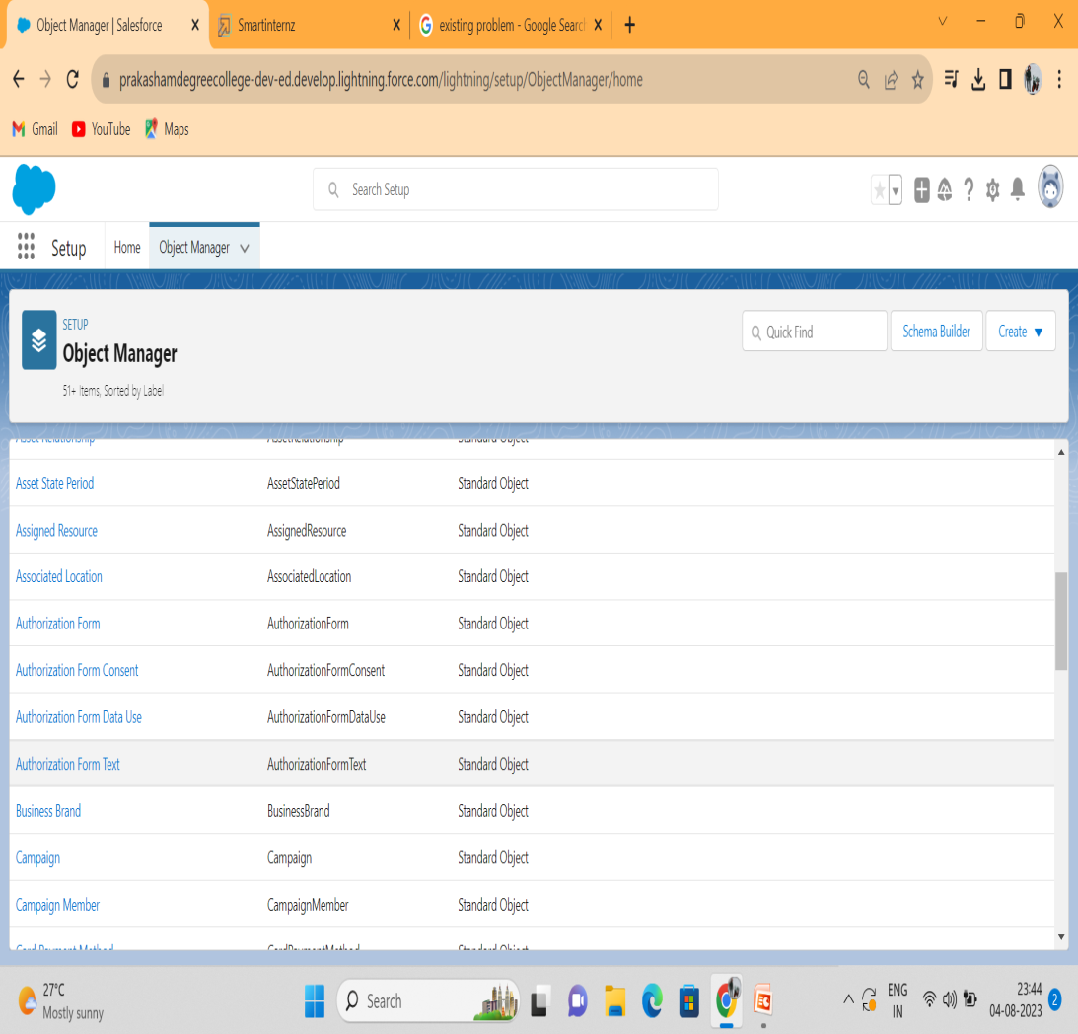
3.Theoritical Analysis : 3.1 Block Diagram For this Travel Approval we need to create 5 objects Department, Employee Detail, Expense, Expense Items, and Travel Approval.. 1. Click on the gear icon and then select Setup. 2. Click on the object manager tab just beside the home tab. 3. After the above steps, have a look on the extreme right you will find a Create Dropdown click on that and select Custom Object. 4. On the Custom Object Definition page, create the object as follows: 5. Label: Department 6. Plural Label: Departments 7. Record Name: Department Name 8. Check the Allow Reports checkbox 9. Check the Allow Search checkbox 10. Click Save.

Slide 5
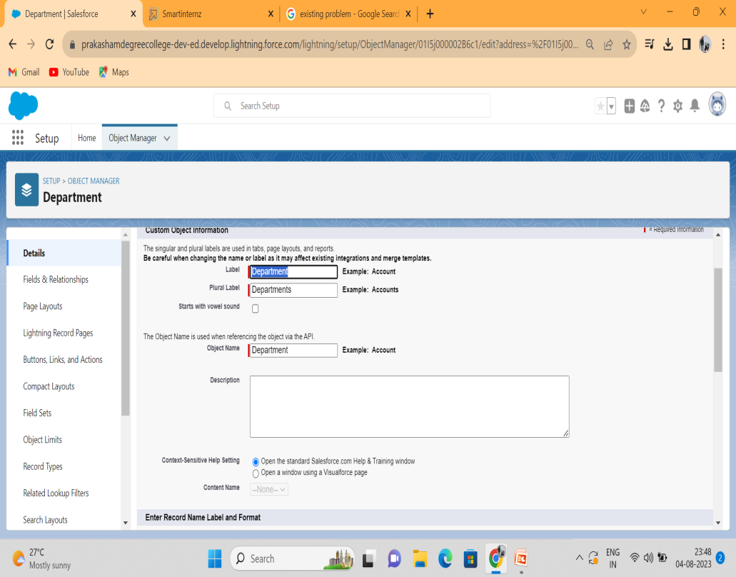
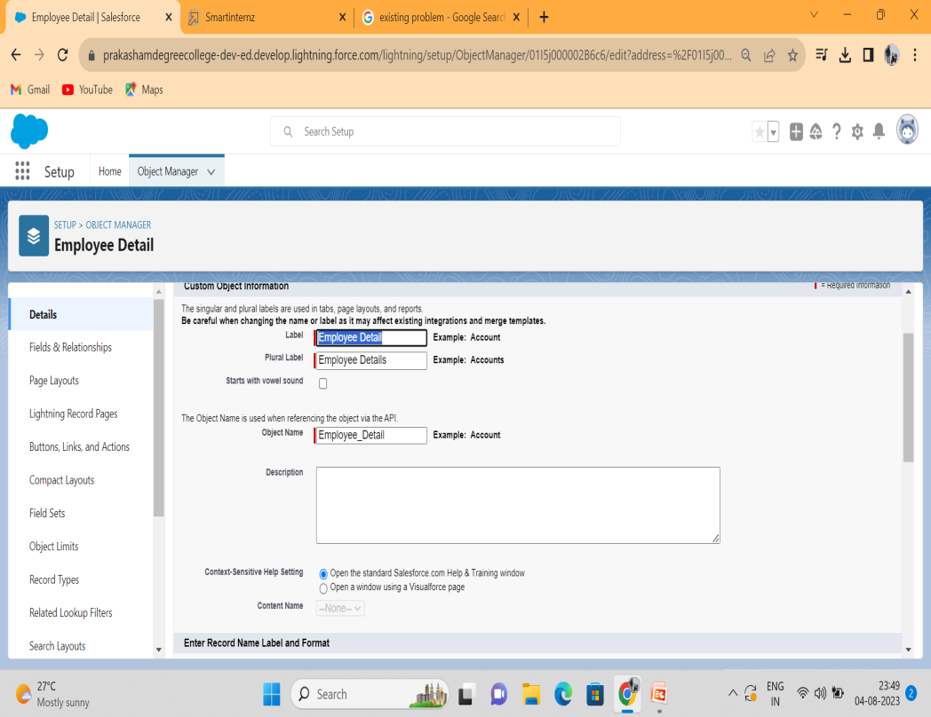
3.2 Hardware / Software Designing In the same way create 4 more objects Employee Detail, Expense, Expense Items, and Travel Approval

Slide 6
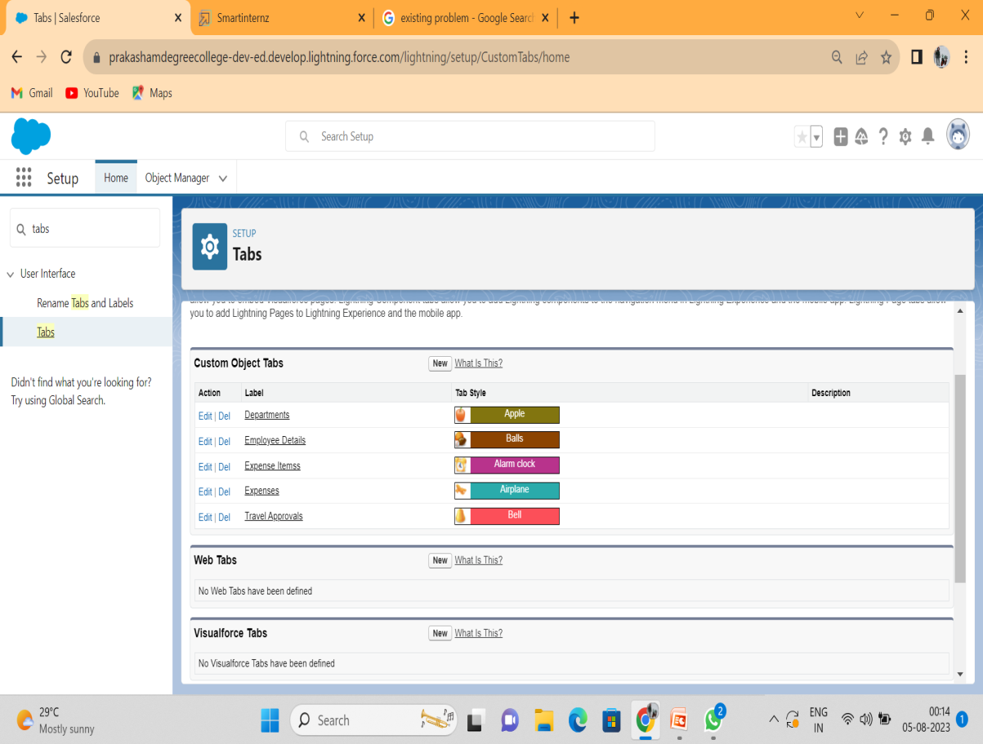
Custom Tab Creation Now create a custom tab. Click the Home tab.
1. Enter Tabs in Quick Find and select Tabs. 2. Under Custom Object Tabs, click New. 3. For Object, select Department. 4. For Tab Style, select any icon. 5. Leave all defaults as is. Click Next, Next, and Save

Slide 7
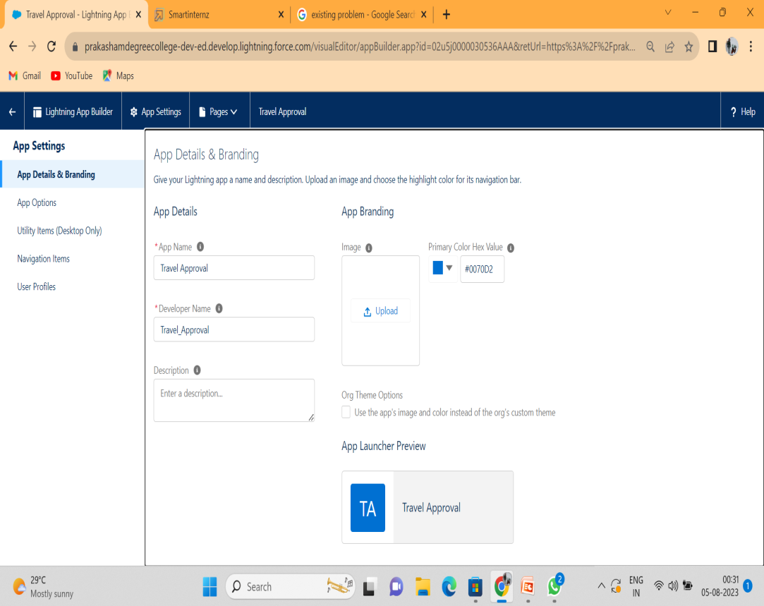
Create Travel Approval App
Click New Lightning App.
Enter Travel Approval as the App Name, then click Next
Under App Options, leave the default selections and click Next.
Under Utility Items, leave as is and click Next.
From Available Items, select Department, Employee Detail, Expense, Expense Items, Travel Approval, Reports, and Dashboards and move them to Selected Items. Click Next.
From Available Profiles, select System Administrator and move it to Selected Save & Finish

Slide 8
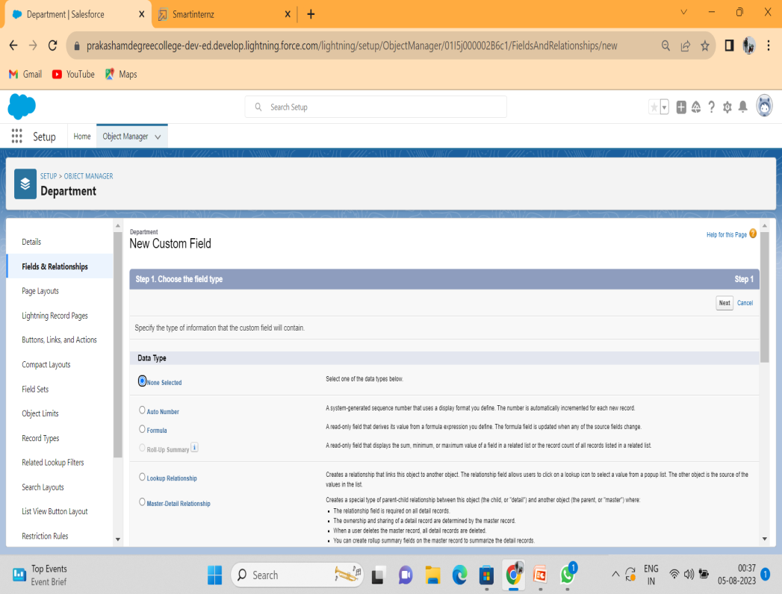
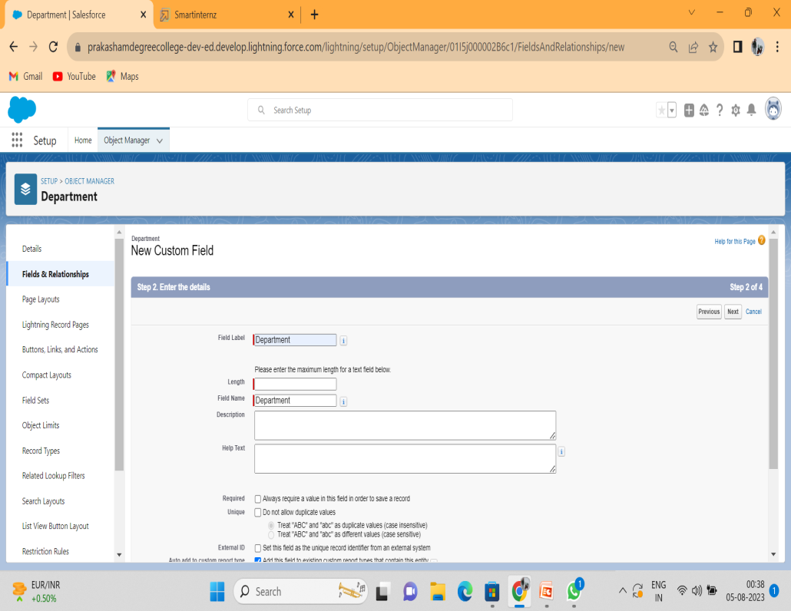
Creation Of Fields For The Department Object

Slide 9
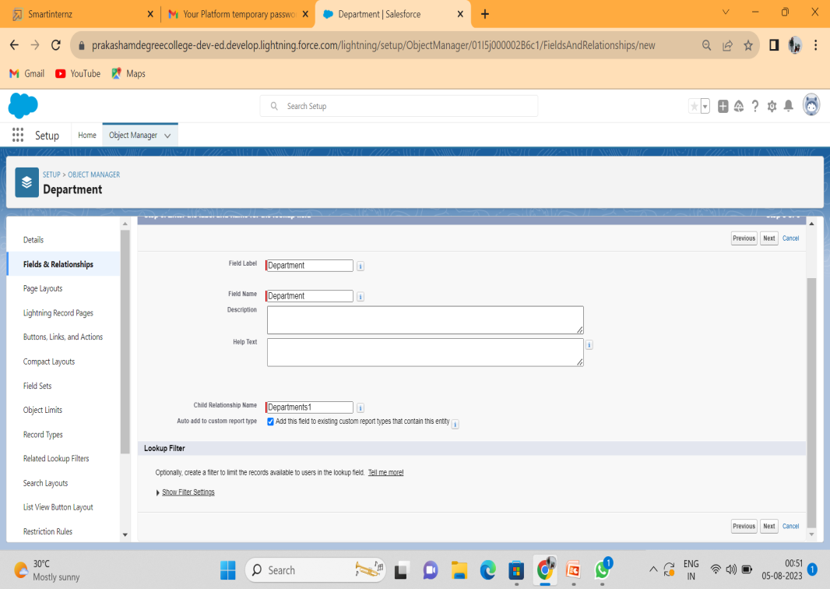
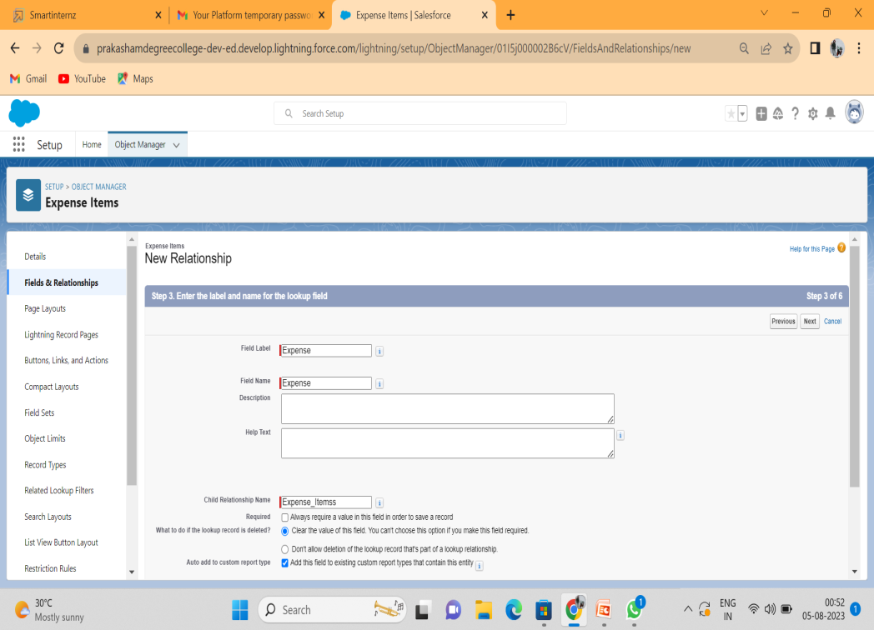
Lookup Relationship With Department
For Field Label, enter Department. Click Next, Next, Next and Save
For Field Label, enter Expense. Click Next, Next, Next and Save.

Slide 10
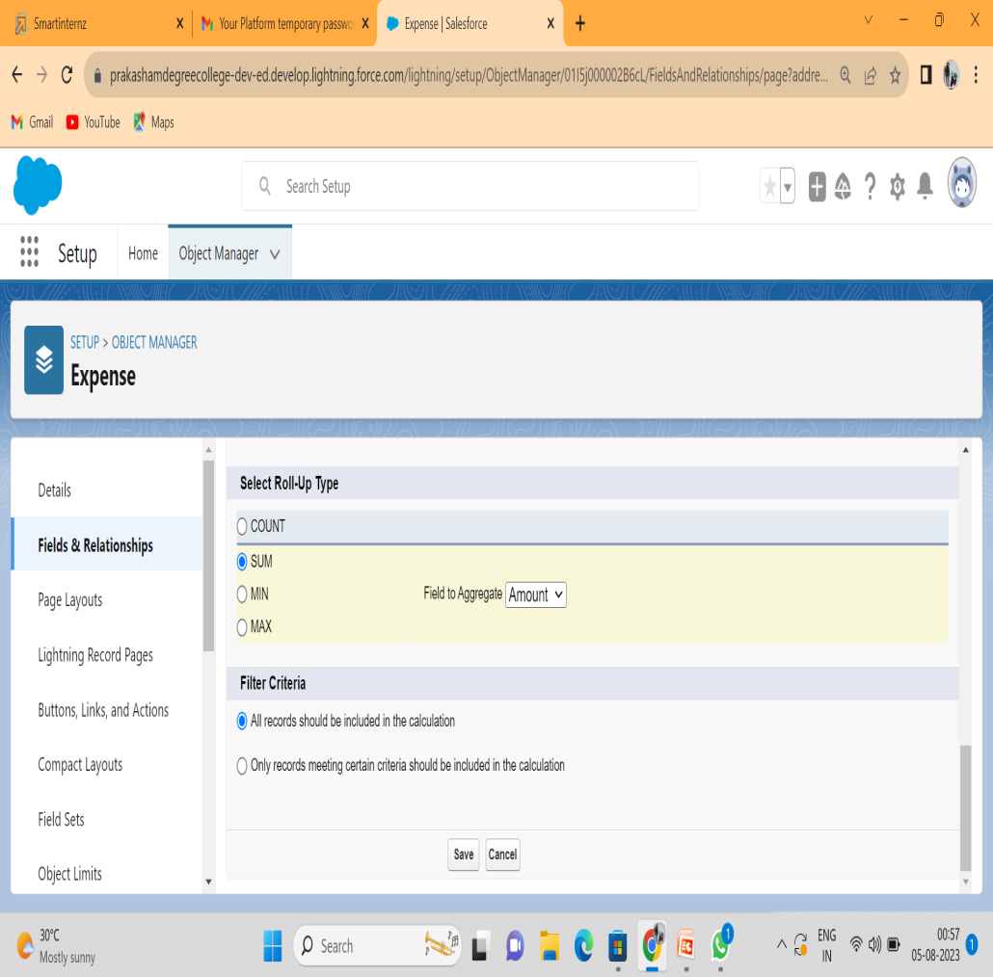
Roll Up Summary Fields On Expense Object
Click the gear icon Select Setup, This launches Setup in a new tab.
click Object Manager
Select Expense.
Click Fields & Relationships
Click New.
Select Sum as roll-up and Field to aggregate Amount then click Next, Next and save.

Slide 11
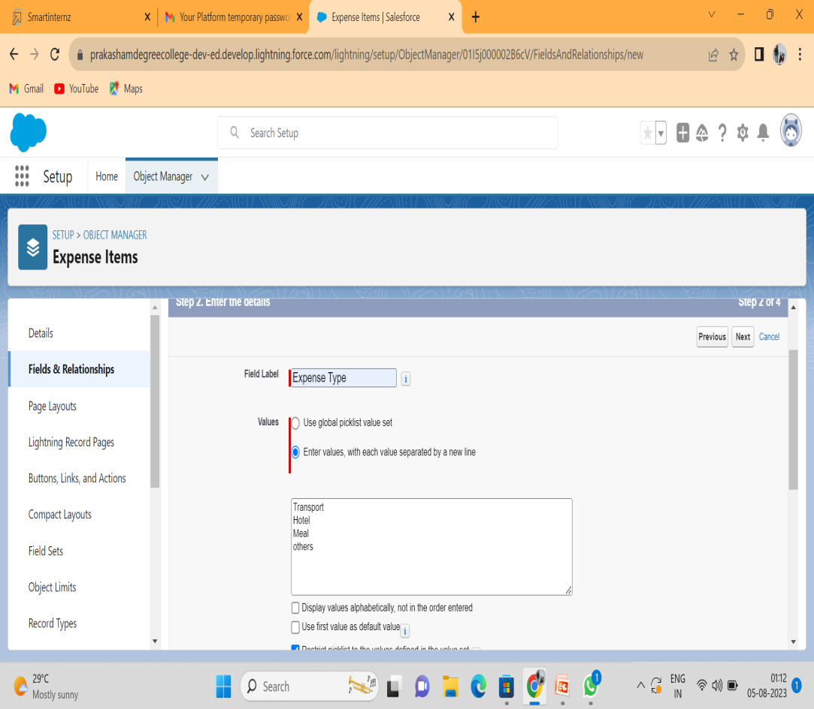
Pick List Field Let’s create a Pick-List field
1) From Setup, click Object Manager and select Expense Item.
2)Click Fields & Relationships, then New.
3)Select Picklist as the Data Type and click Next.
4)For Field Label enter Expense Type
5)Select Enter values, with each value separated by a new line, and enter these values:
Transport
Hotel
Meal
others
Click Next, Next, then Save & New

Slide 12
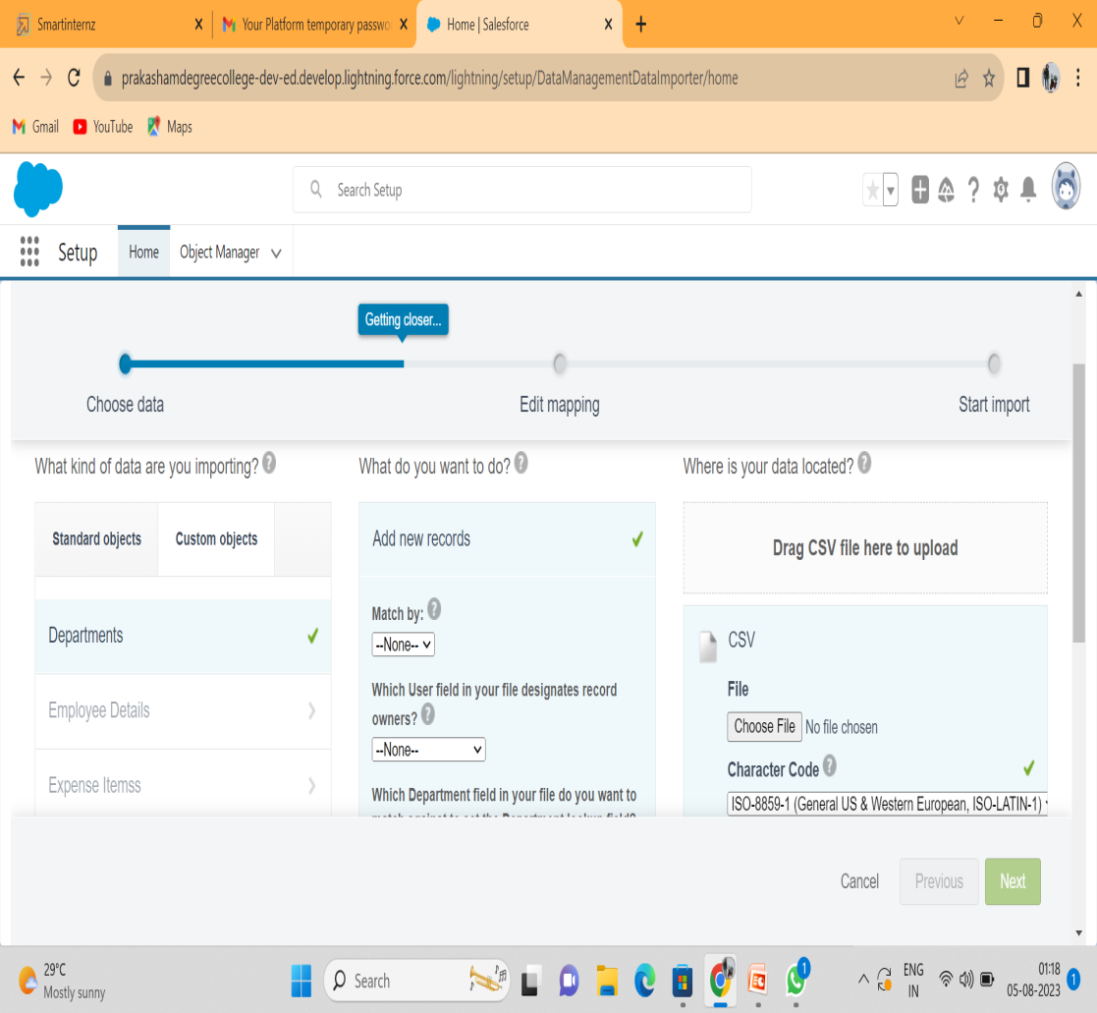
Data Import
1)In the Quick Find box, enter
Data Import and select Data
Import Wizard.
2)Click Launch Wizard!
3)Click the Custom Objects tab and select the Departments object.
4)Select Add new records.
5)Click CSV and choose file Department CSV which we made earlier. Click Next.
6)Since the field names in the CSV file (CSV Header) are the same as the field names in your object (Mapped Sales force Object), the fields are automatically mapped. Click Next.

Slide 13
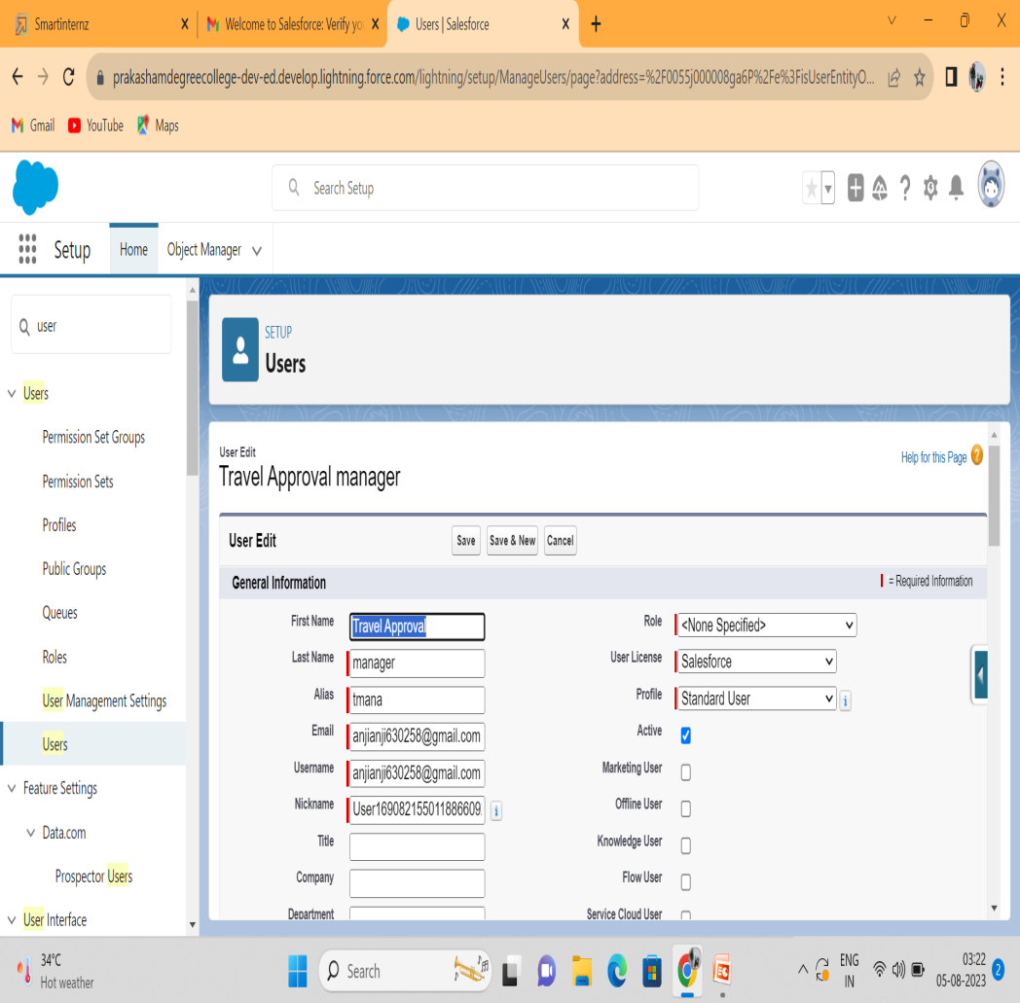
Creating A User In Salesforce
1.From Setup, in the Quick Find box, enter Users.
2.Select Users.
3.Click New User.
4.Enter the First Name Travel Approval and Last Name manager and (Your) email address and a unique username in the form of an email address. By default, the username is the same as the email address.
5.Select a User License as Salesforce.

Slide 14
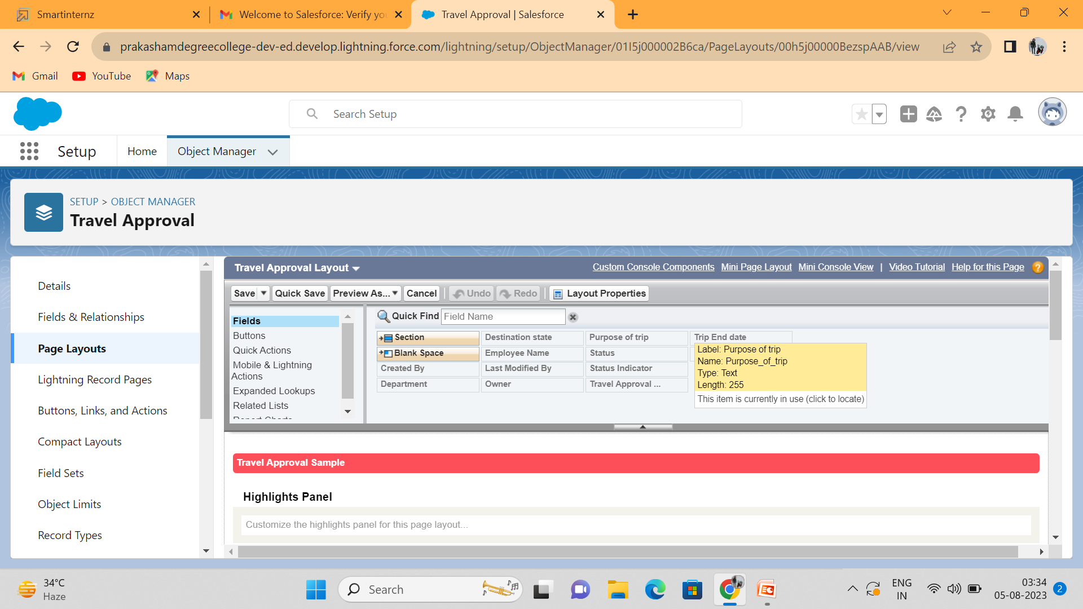
Customize Travel Approval Object Page Layout

Slide 15
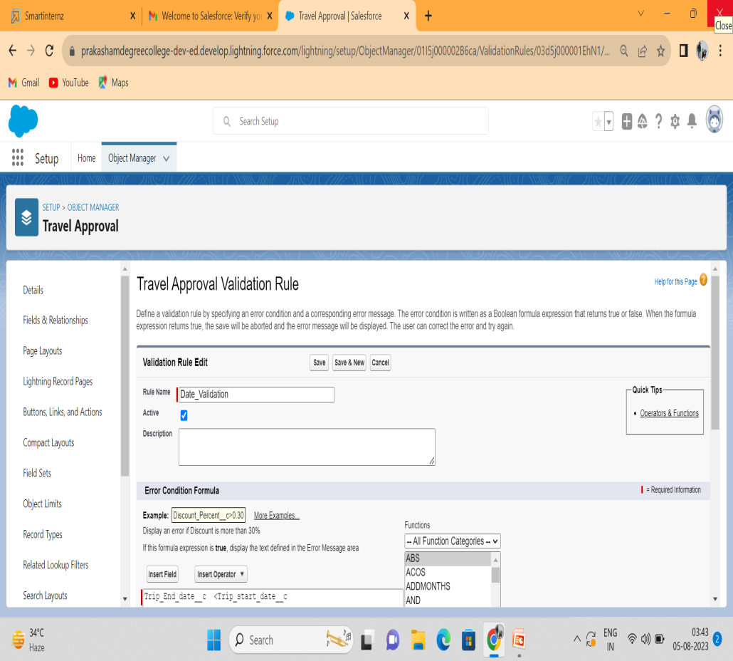
Create Validation Rule
1)Click on validation rules and click new on the left corner
2)Give your rule name Date _Validation and make sure that the rule is set to active.
3)In the error condition formula enter Trip_End_Date c < Trip_Start _Date c
Give the Error message – “Trip end date must be the date greater than the Trip start date” & For error location select the field and pick the Trip end date as the location for error. Click save.

Slide 16
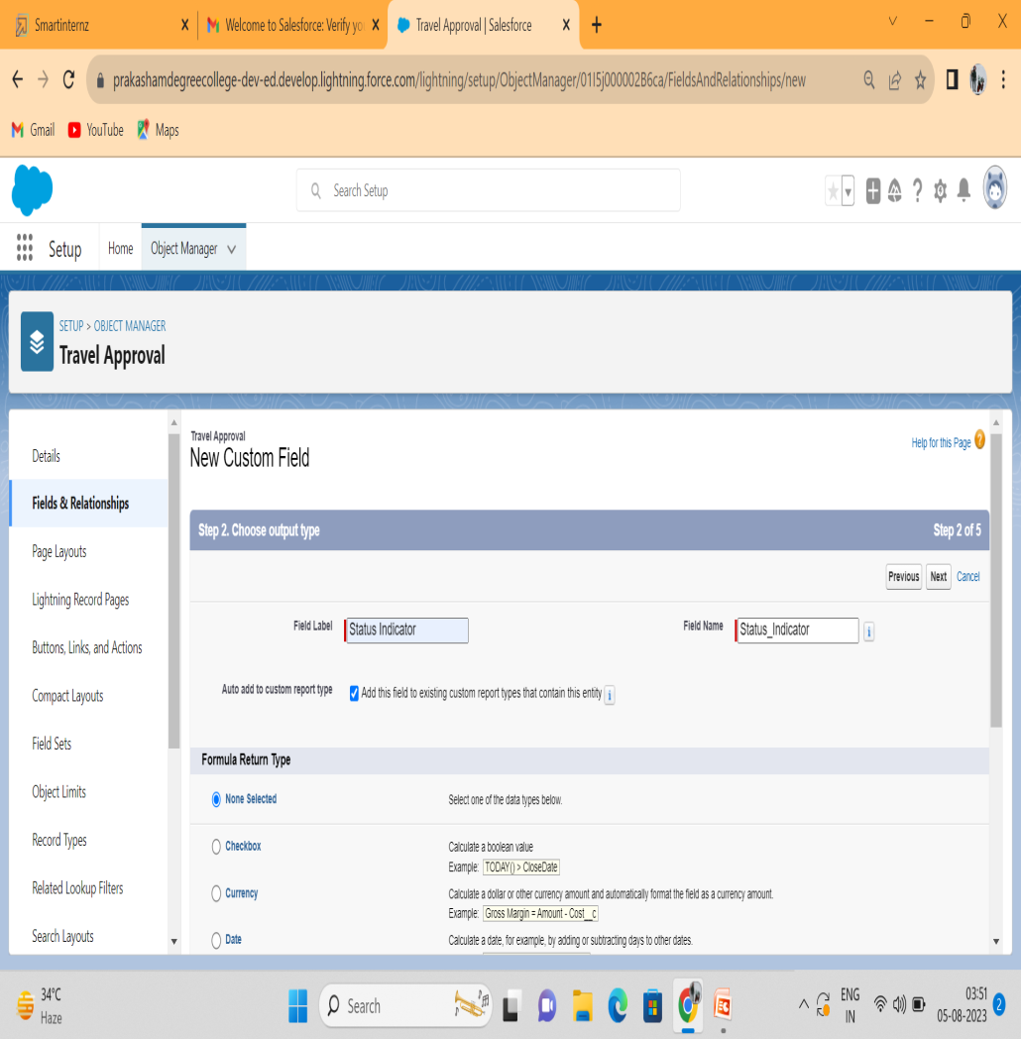
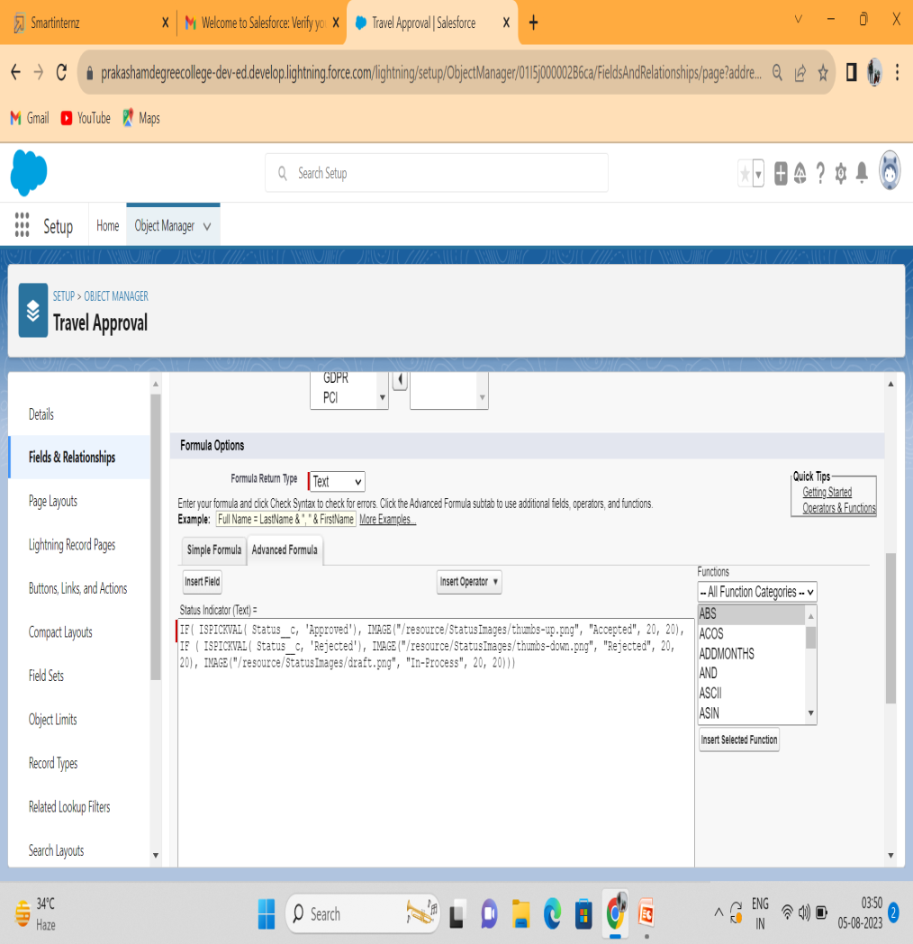
Create Formulae Fields
Enter the field label and field name.
Enter the formula clike save.

Slide 17
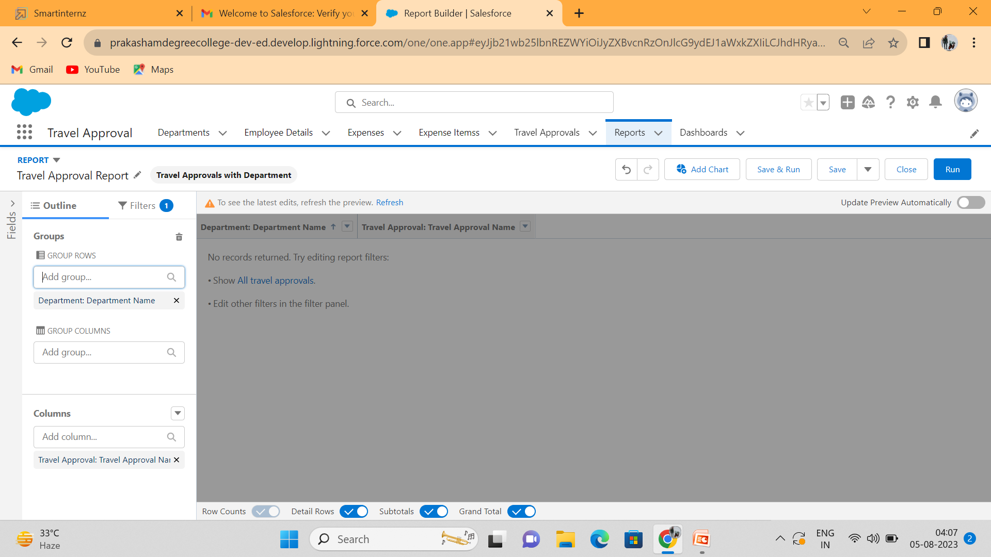
Create Record
1)Click reports tab
2)Click New Report.
3)Click the report type as Travel approval with Departments Click Start report.
4)Customize your report, in group rows select - Department Name
5)Click refresh
6)Click save and run
7)Give report name – Travel Approval Report
8)Click Save.

Slide 18
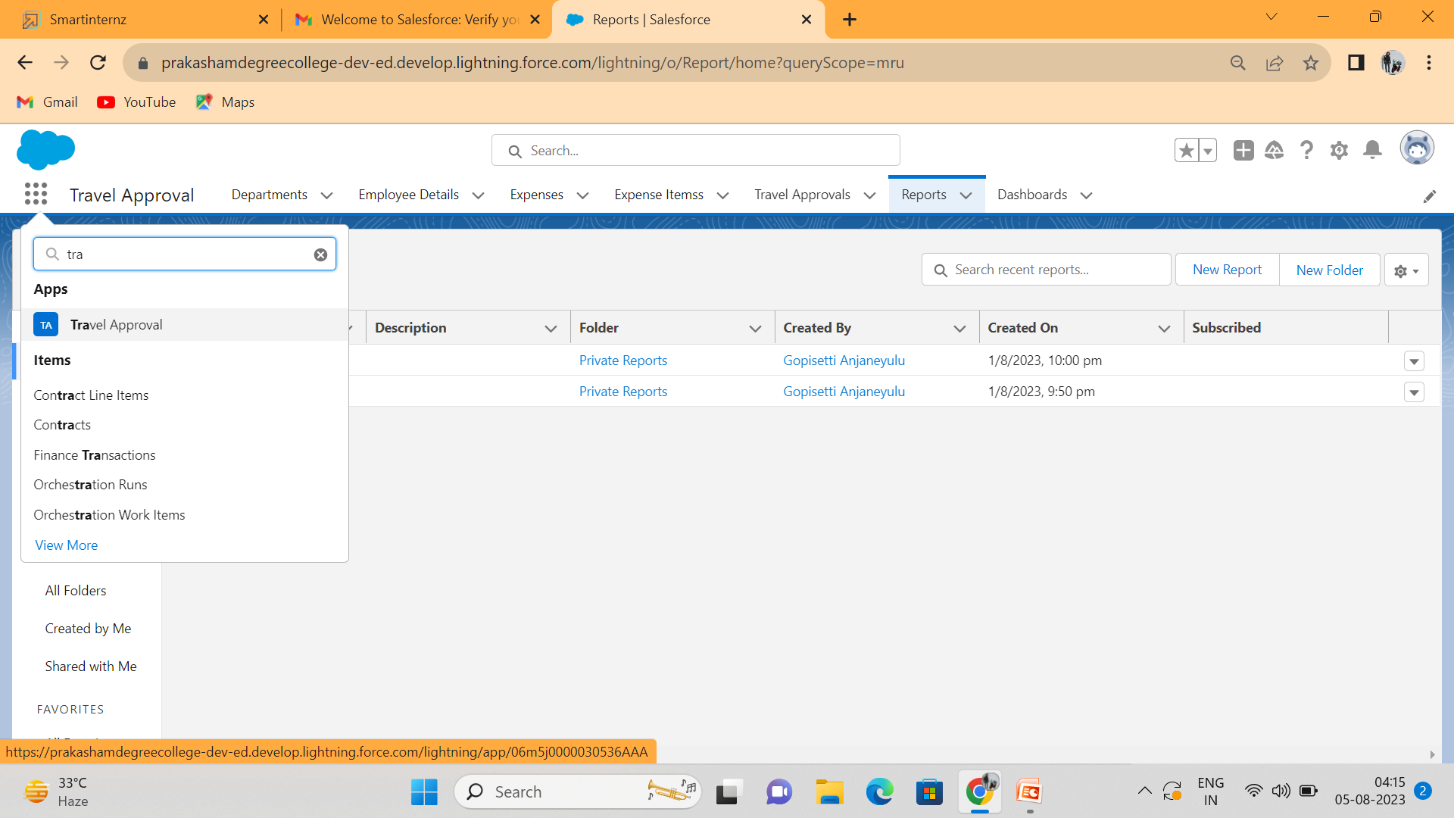
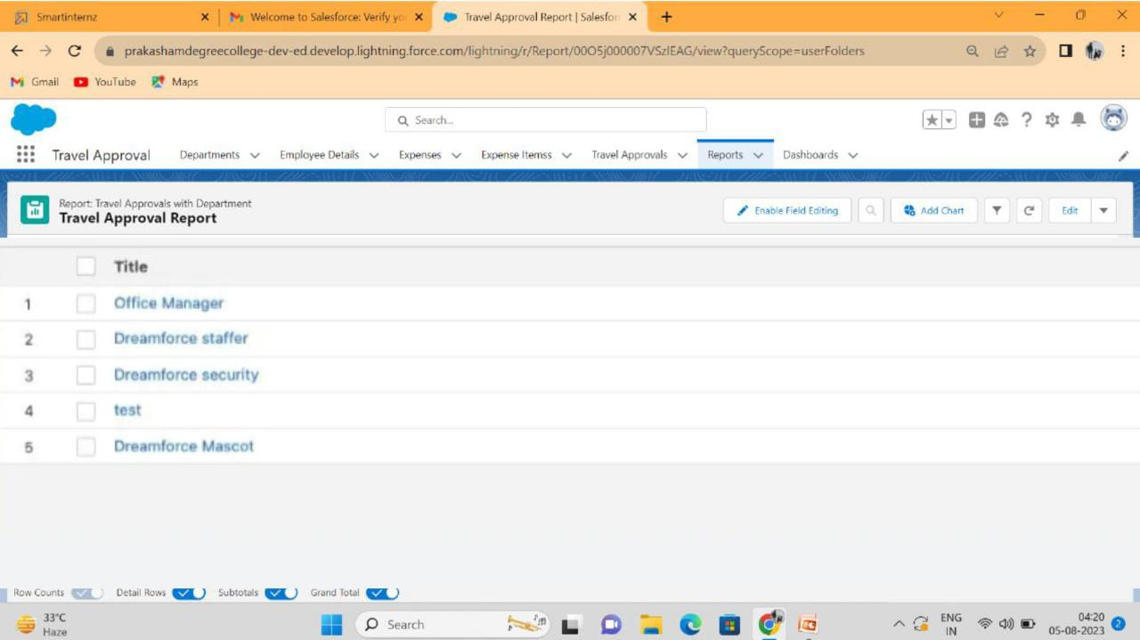
View Record

Slide 19
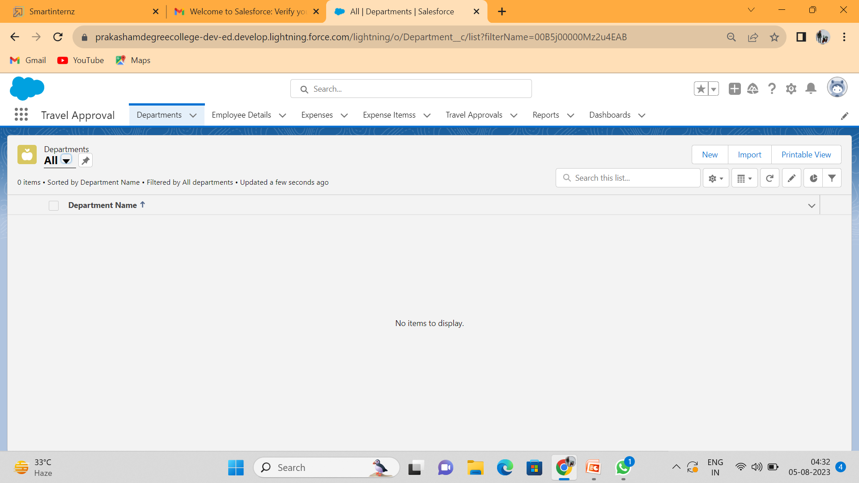
Delete Record Department record delete process

Slide 20
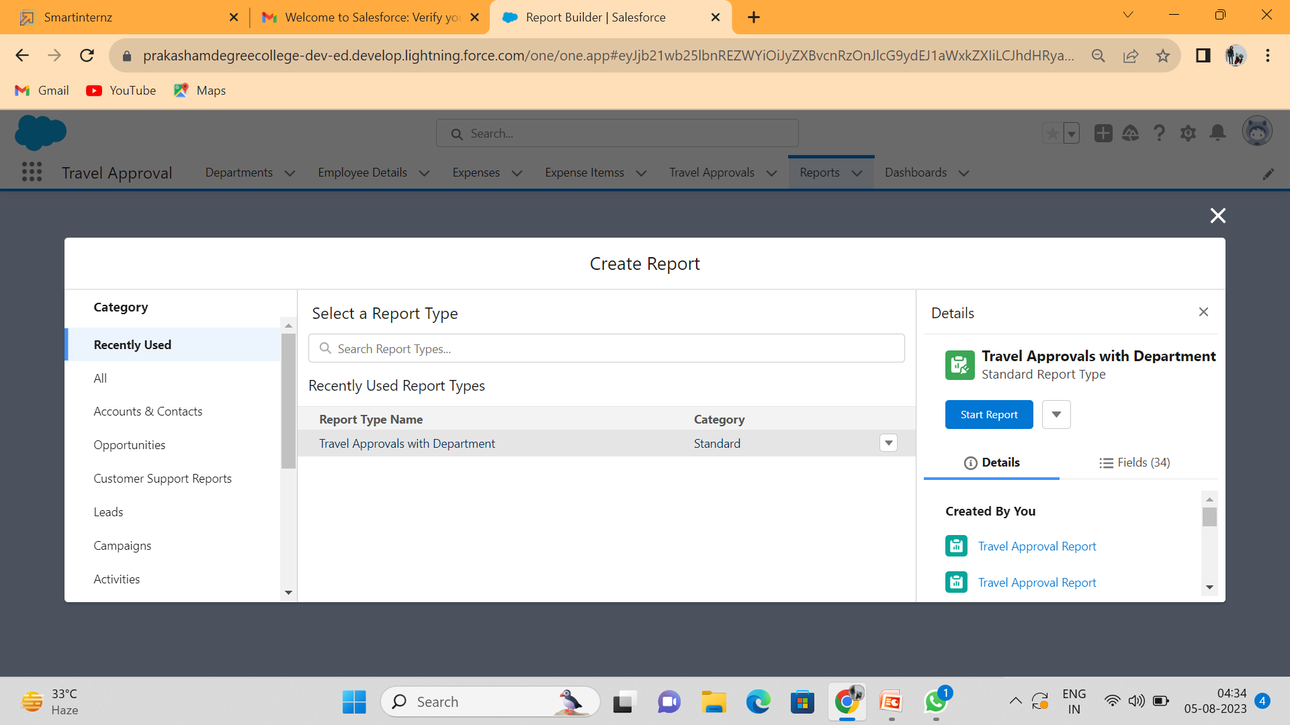
Create Report
1. Click App Launcher and select Travel Approval App
2. Click reports tab
3. Click New Report.
4. Click the report type as Travel Approval with Departments Click Start Report.
5. Customize your report, in group rows select - Department Name
6. Click Refresh
7. Click save and run
8. Give report name – Travel Approval Report
9. Click Save

Slide 21
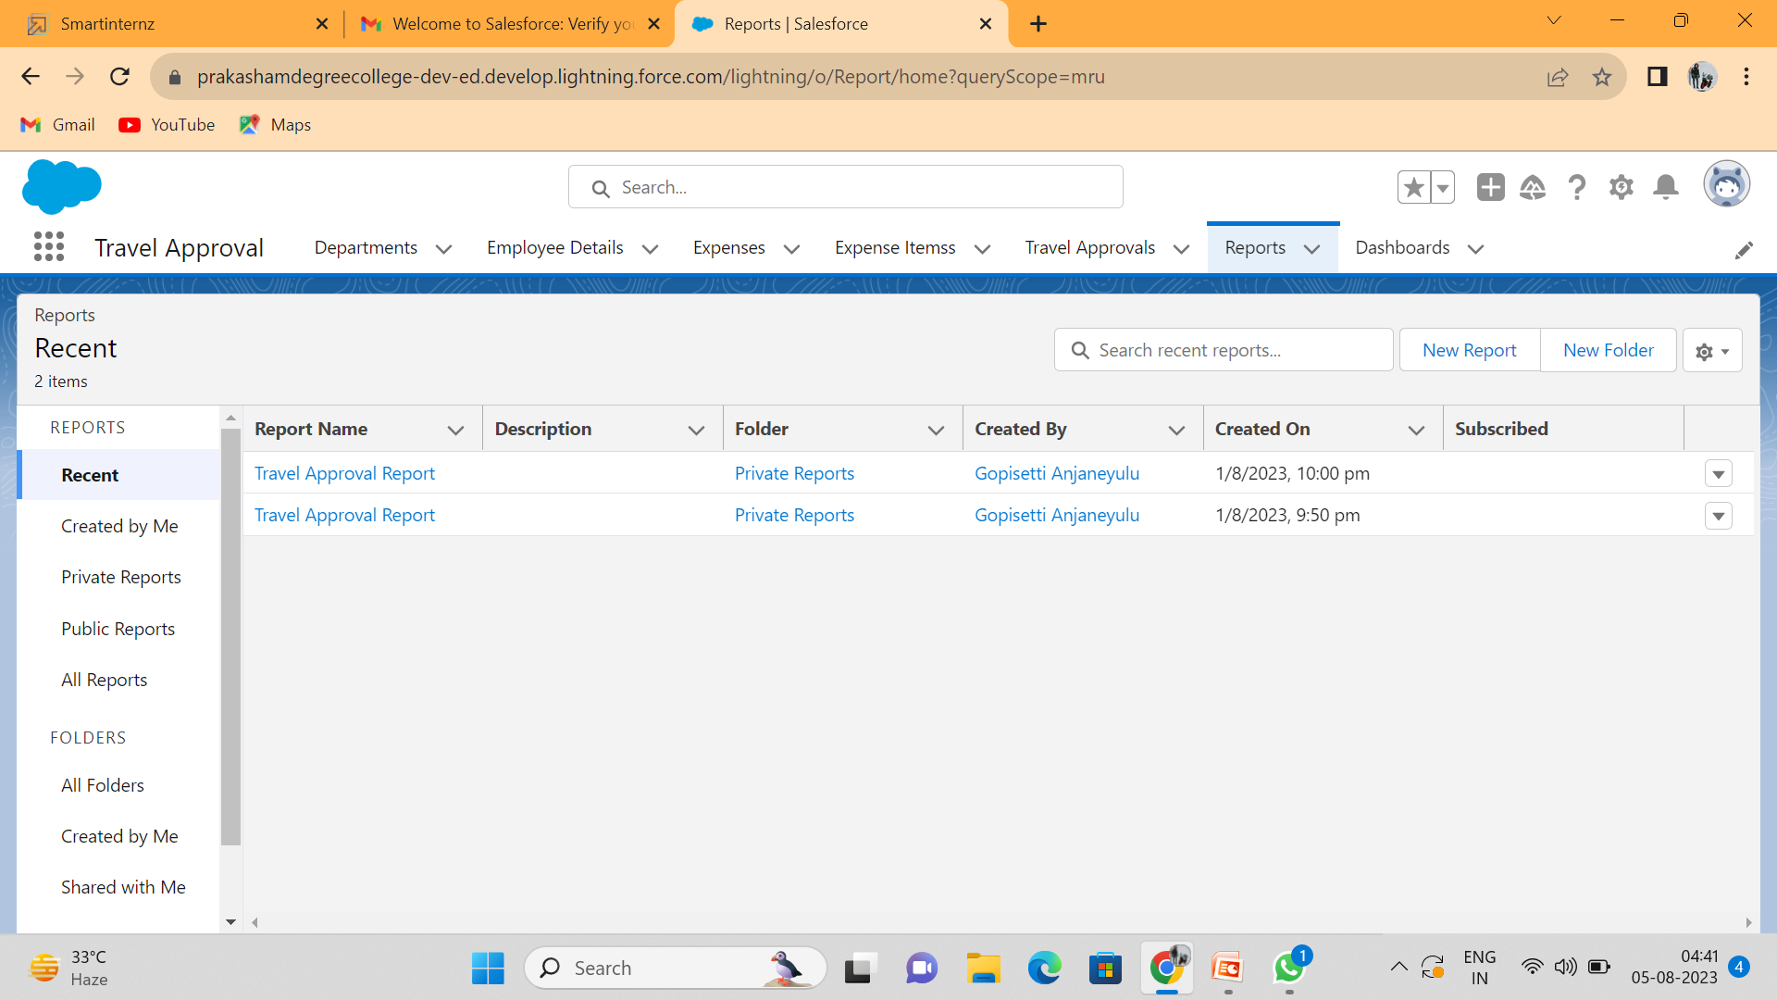
View Report Travel Approval Report and see records

Slide 22
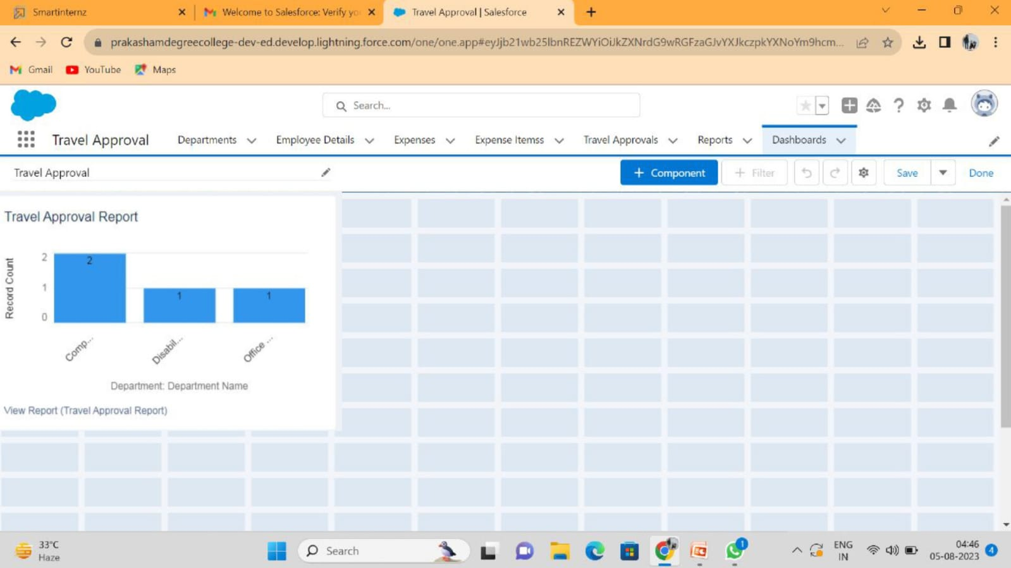
Create Dashboard
Click on a new dashboard
Give name- Travel Approval
Click Create
Give your dashboard a name and click on +component, select the Travel Approval
Report that you created.
For the data visualization select any of the chart, table etc as your wish.
Click add Click save.

Slide 23

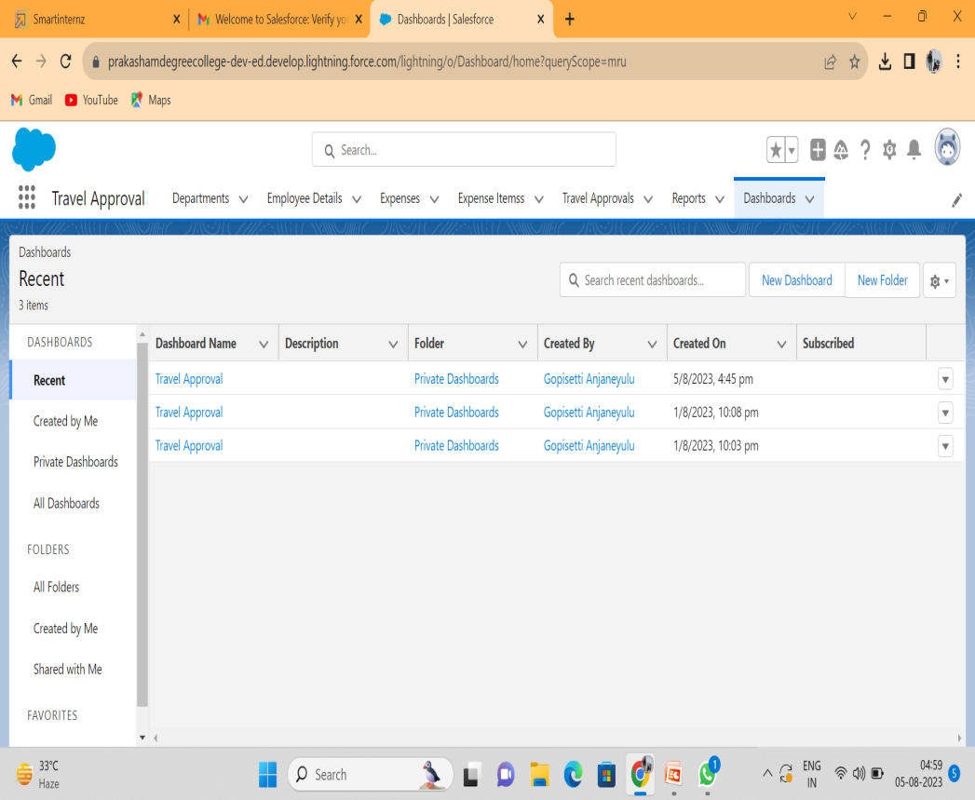
View Dashboard Travel Approval and see graph view of records

Slide 24
4.Result
a
Object Name
Travel Approval
Formula Field
Status Indicator
Fields in the object Field label | Data type
Amount | Currency
Expense type field | Pick list
Travel Approval field | Master Detail Relationship
Total Expenses | Roll-up Summary
Status Images | Formula
Status Indicator | Text

Slide 25
5.Advantages :
The process is tedious and time-consumingtask
Easiest way
Saves time for both employees and managers
Reduces the workload
The entire process is digitized and streamlined
Increased Transparency
Provides greater control and security over employee travel.

Slide 26
Disadvantages :
The process includes too many levels of approval that make tedious and confusing
Regular Maintenance
Internet Connection problem is there
Poor Connection leads to trouble and anxiety e. Lack of leadership
It can be costly sometimes
Poor communication.

Slide 27
6.Applications :
The application ensures that travel requests comply with the company's travel policies which reduces the risk of non-complaint expenses and unnecessary travel. The application helps reduce travel costs by allowing the company to track expenses and stay within budget. This also helps the company negotiate better deals with travel vendors. The application saves time for both the employee and the travel manager by automating the travel request and approval process. This allows the HR department and travel managers to focus on more strategic tasks.

Slide 28
7.Conclusion :
An employee travel approval application is a valuable tool for corporate travel management. It streamlines the travel request and approval process ensures policy compliance, and provides transparency to all parties involved. A well- designed application can save time and money, making it an essential tool for corporate that frequently travel for business.

Slide 29
8.Future Scope :
In future it will be really a useful one in the application of travel approval.
It is trusted to be in future everyone willutilize this.
The customer will set good service and makeit trustworthy.

